Slide 1
SlugDoc: UCSC’s
COVID-19 Chatbot
Ian Hardy, Rohit Das

Slide 2
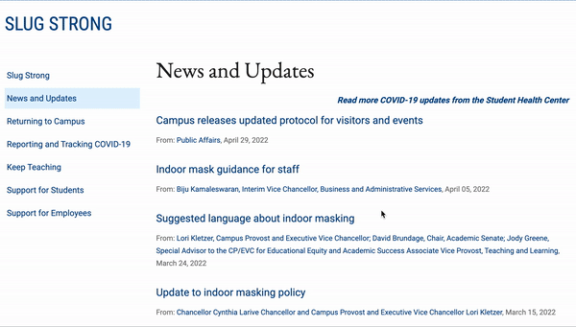
Motivation
Throughout the COVID-19 pandemics, one of the best protections against the virus has been knowledge
How to protect yourself, how to protect others, how and when to access care, etc.
There are a wealth of resources available
However, there’s almost “information overload”
How do you know what resources to trust?
How do you navigate resources effectively?
We wanted to create SlugDoc as an easy-to-use conversational IR model for providing trustworthy information seamlessly
How do you get critical information quickly and easily?

Slide 3
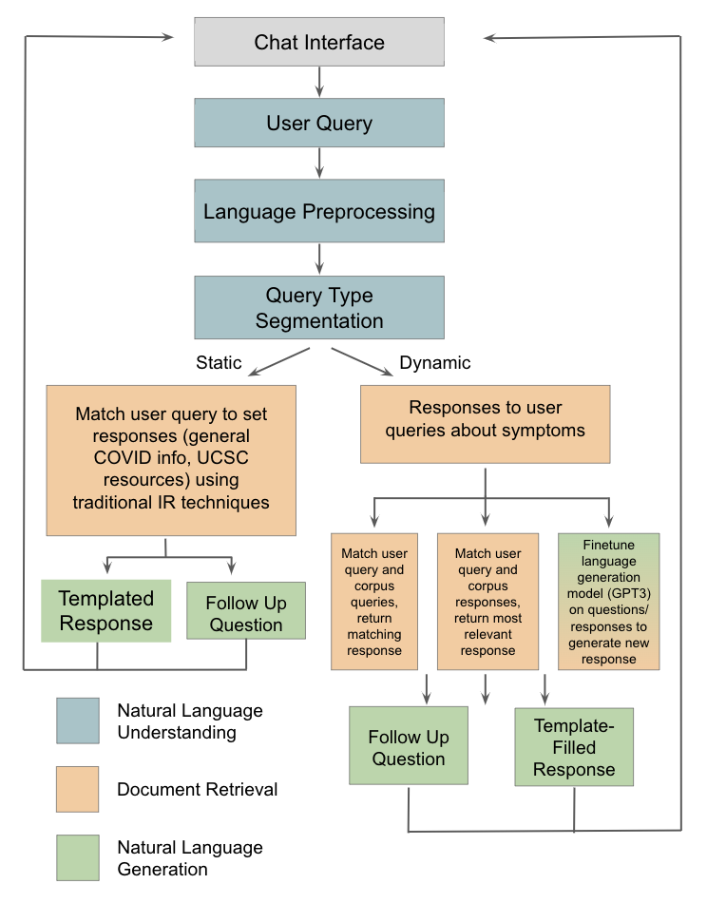
Originally Proposed System Diagram
Goals:
Use natural language understanding to detect a user’s information needs
Based on the detected needs, return either:
Templated informational responses
Dynamic responses based on symptomatic concerns
The ability to ask follow-up questions and maintain a dialogue
Notes:
GUI created using tkinter.
Other libraries include NLTK,tensorflow and keras.

Slide 4
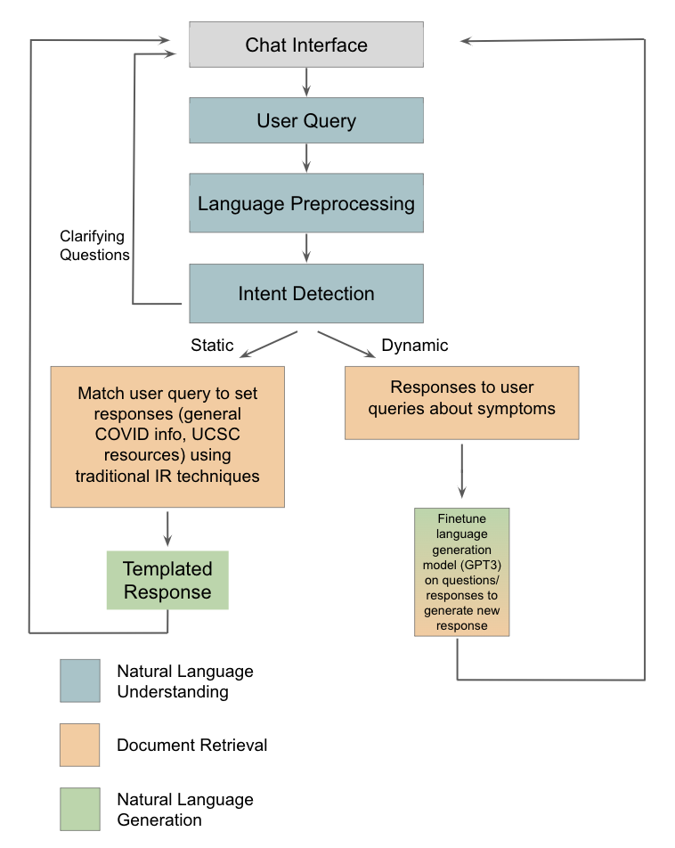
Final System Diagram
End Result:
We use natural language understanding to detect a user’s information needs with 90% accuracy
Based on the detected needs, we return either:
Templated informational responses
Dynamic responses based on symptomatic concerns
We have the ability to ask follow-up questions and maintain a dialogue

Slide 5
Component: Natural Language Preprocessing
Currently we are utilizing data which has been collected from the SlugStrong webpage, COVID-dialogue dataset and some generic responses collected from google.
Tokenization: The process of breaking a the text into smaller tokens/words. This is done using the NLTK library.
Lemmatization: The process of converting the tokens into the lemma form which can be used while predicting the required response to a query.

Slide 6
Component: Natural Language Understanding (Intent Model)
“Can the virus spread be stopped?’
The intents dataset contains multiple sets of utterances and their respective intents
e.g. “Can the virus spread be stopped?” maps to “precautions”
We compiled over 2400 such utterances spanning 13 intent categories
We trained a 3 layer deep neural network using SGD for 200 epochs to predict an intent category from an utterance
Surprisingly good accuracy for a simple B.O.W. approach
0
1
0
0
…
1
0
0
1
…..
…..
…..
“Precautions”

Slide 7
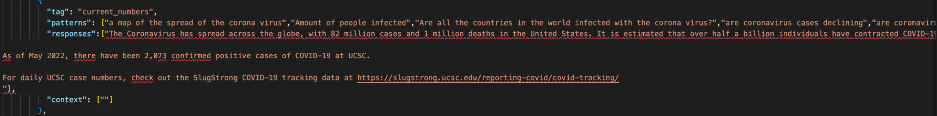
Component: Natural Language Generation (Static)
A json file which contains categories of responses to certain intents have been generated and the response to certain generic queries such as UCSC specific COVID-19 information would be fetched using the intents model.
A small sample of this:-

Slide 8
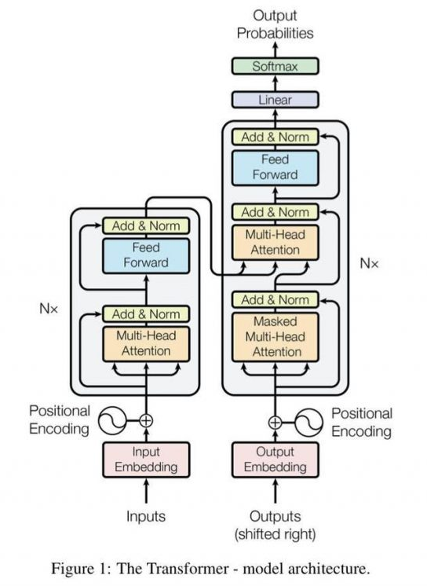
Component: Natural Language Generation (Dynamic)
Available data:
604 conversations between doctors and patients across three telehealth websites
Ad Hoc Approaches:
Match a user’s query to the closest patient dialogue, return the corresponding doctor response
Match a query directly to the most relevant doctor response
Issues: unnatural/off-topic, overly personal, key word limitations
Decided to put most of our efforts into generative language modeling - GPT-2
Hopefully more “natural” sounding
Can leverage on previously-learned term associations
Idea: fine-tune on our dataset

Slide 9
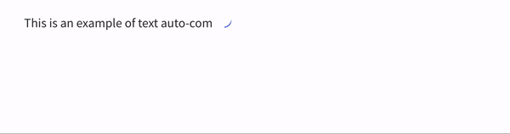
Generative Model Functionality
Example taken using GPT-2 via https://transformer.huggingface.co/
Things to note:
Variable-length outputs
Probabilistic approach (highest probability is not always the most “natural”)

Slide 10
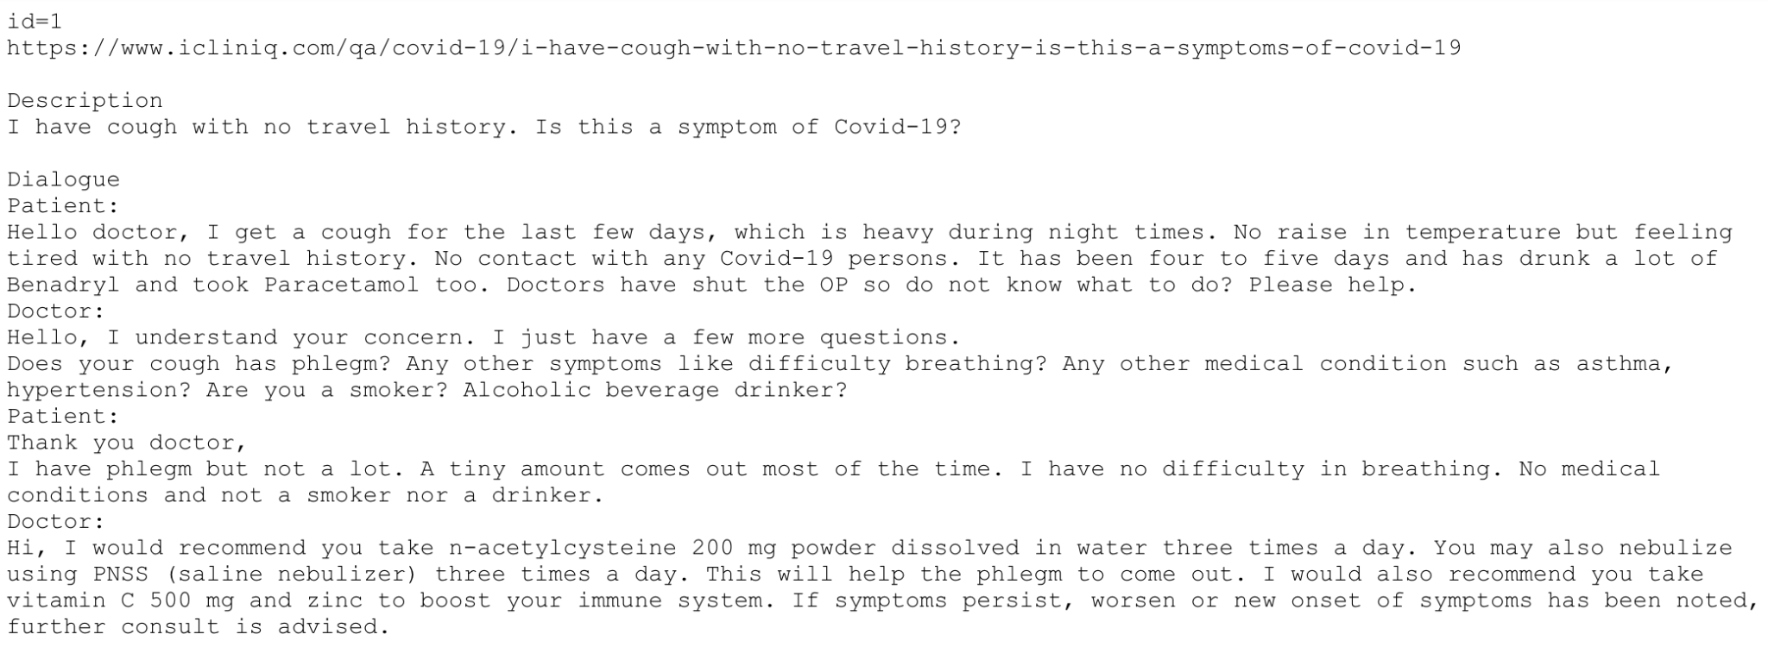
Generative Model: Input Data & Cleaning
Description (used for evaluation)
Training Data
(Scripted language removed)

Slide 11
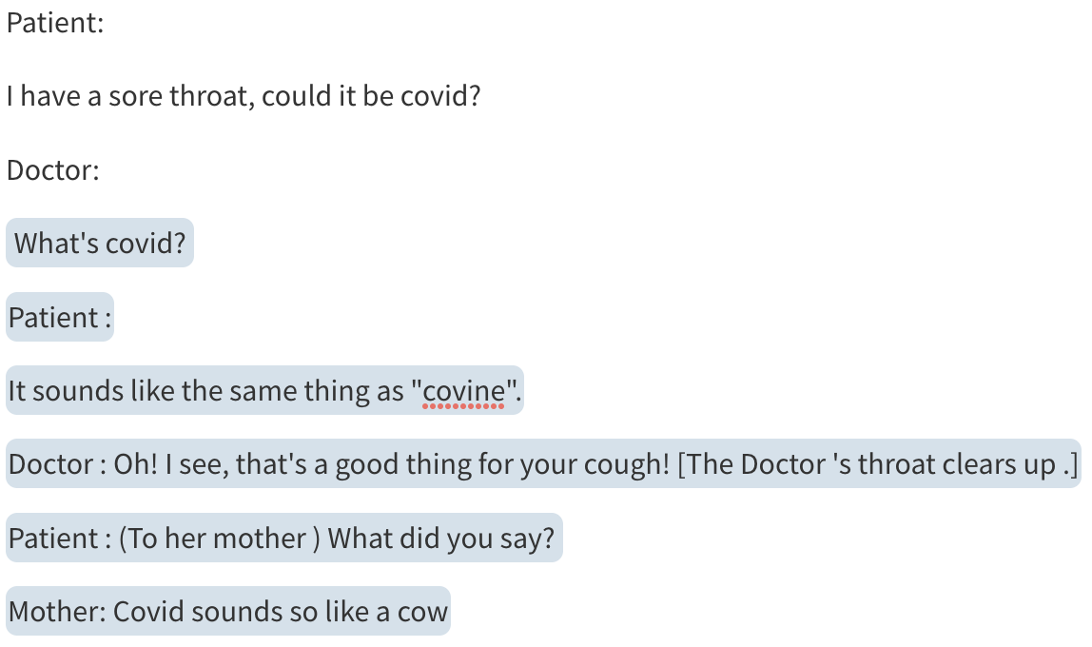
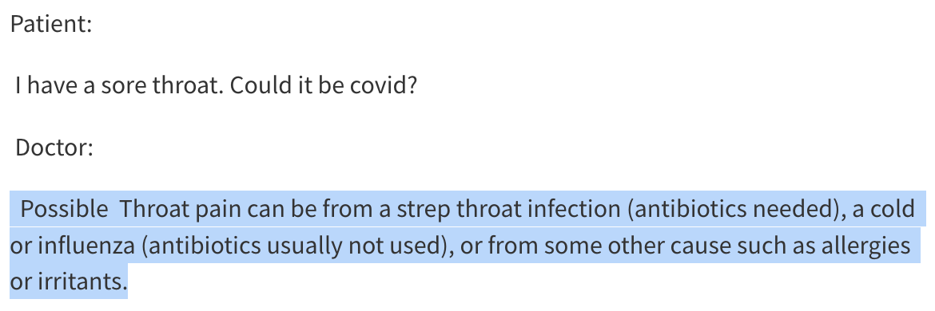
Generative Model- Fine-Tuning
“Baseline” GPT-2 Model
“Fine-tuned” GPT-2 Model
Highlighted Text = Generated by GPT-2

Slide 12
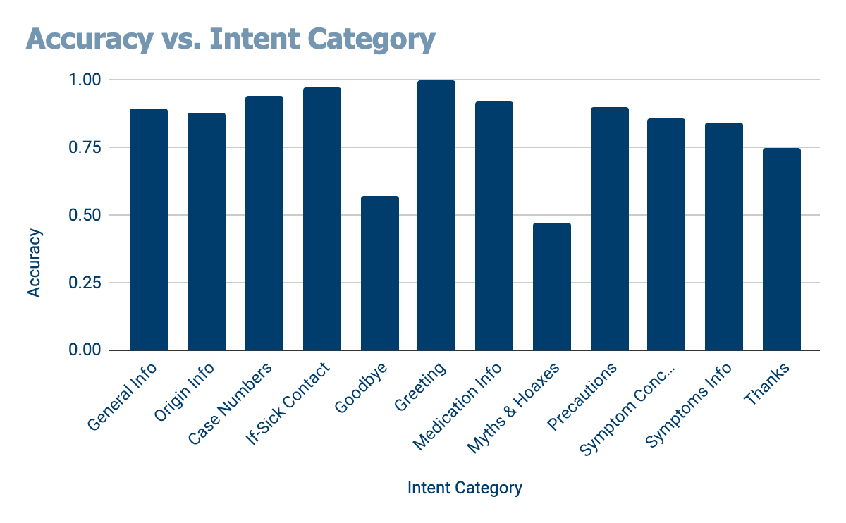
Evaluation Results: Intent-Detection
Trained the intent model on 80% of each category’s utterances
Tested the accuracy of the intent model’s prediction (top 1) on the remaining 20% (483 utterances)
Results are broken down on the right
Overall: 89.7% Accuracy

Slide 13
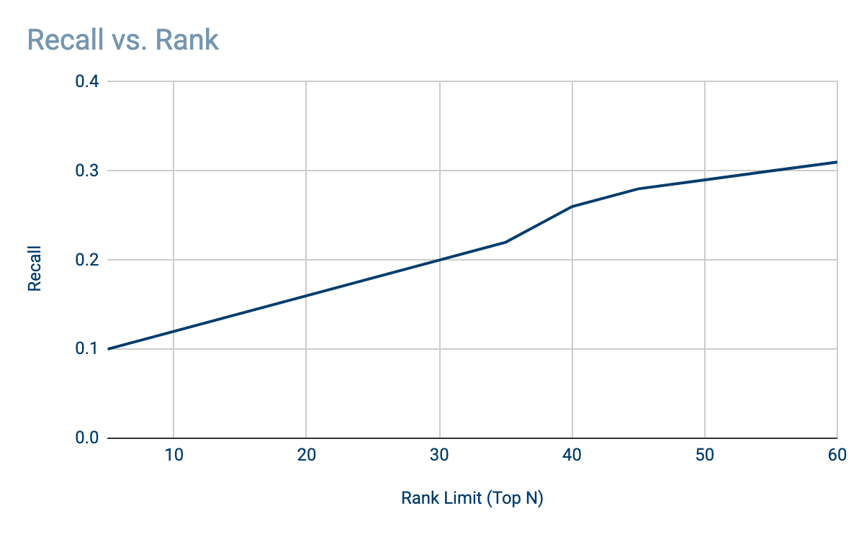
Evaluation Results: Dynamic Responses
For each dialogue description we generated a response with our fine-tuned model
Core idea: the generated response should be similar to the real doctor’s response for that “kind” of dialogue
We treated the real doctor responses as documents, and attempted to retrieve the correct response from the generated response
We then observed the top-K recall at various thresholds

Slide 14

A video sample of our progress so far…

Slide 15

Takeaways
SlugDoc is still in its infancy, but it presents an easy to use interface for accessing authoritative information about COVID-19
Understanding a user’s intent (i.e. their information needs) is the a core goal for conversational agents
Data is important!! A lot of work went into gathering useful data for training our intent model, refining our responses and fine-tuning our generative model
We show some promising initial results for generative model conversational agents, but it is far from perfect
Ethical concerns about when generative models can/should be deployed for communicating important information

Slide 16
Future Work
Including automated testing reservations.
Hyperlink support
Creating an easy means of updating responses as information changes.
Faster responses when utilizing the generative model.
Improved filtering mechanisms for the generative models results.
More advanced intent model architecture
Testing and utilizing better models for faster and more accurate responses to user queries.
Expert-Informed hierarchical evidence model?
DeepQA-style model?

